Slide 1
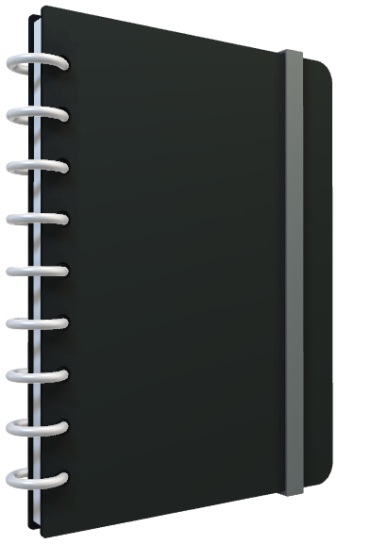
AzureML with Jupyter notebooks
Riedwaan Bassadien
Data & AI Specialist

Slide 2
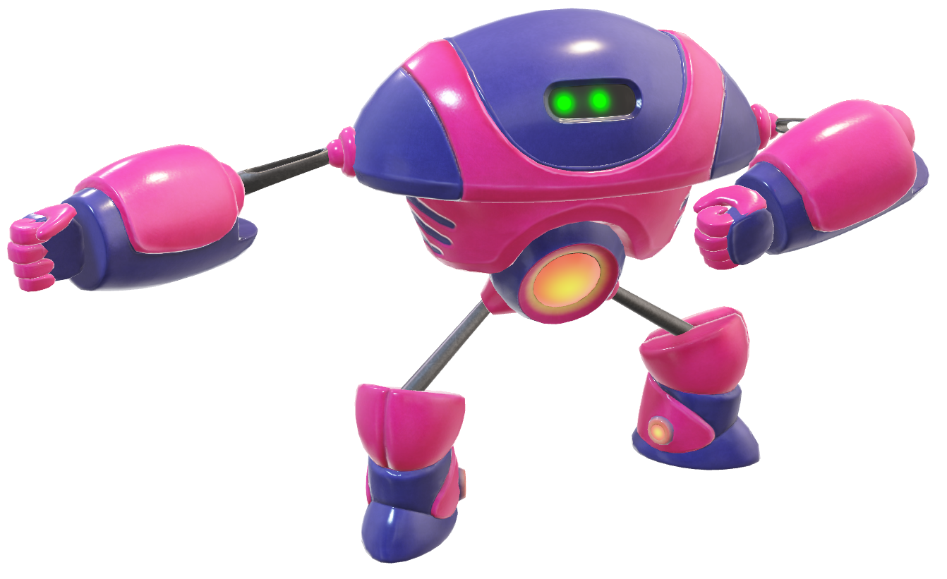
Azure Machine Learning service
Set of Azure Cloud Services
Python SDK
That enables you to:
Prepare Data
Build Models
Train Models
Manage Models
Track Experiments
Deploy Models

Slide 3

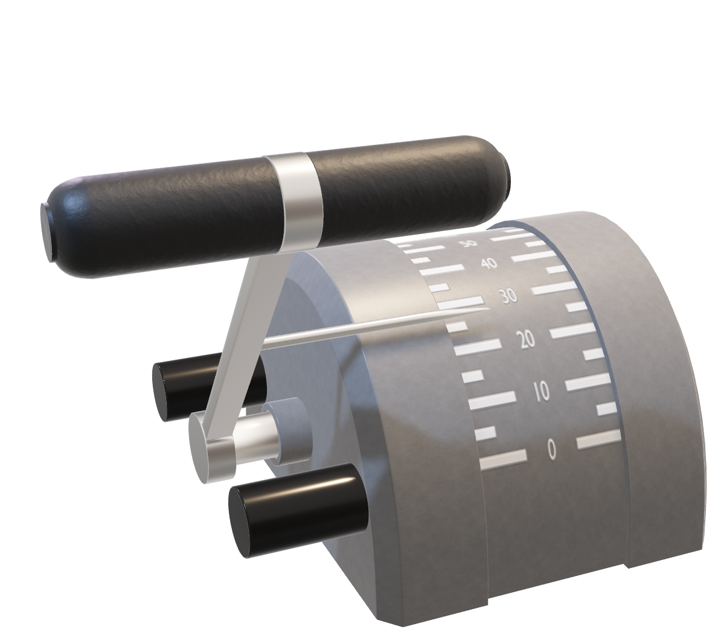
Azure ML for ALL skill levels
“Code First Experience”
Python SDK
Designer GUI
Control
AutoML Wizard
Skill Level

Slide 4
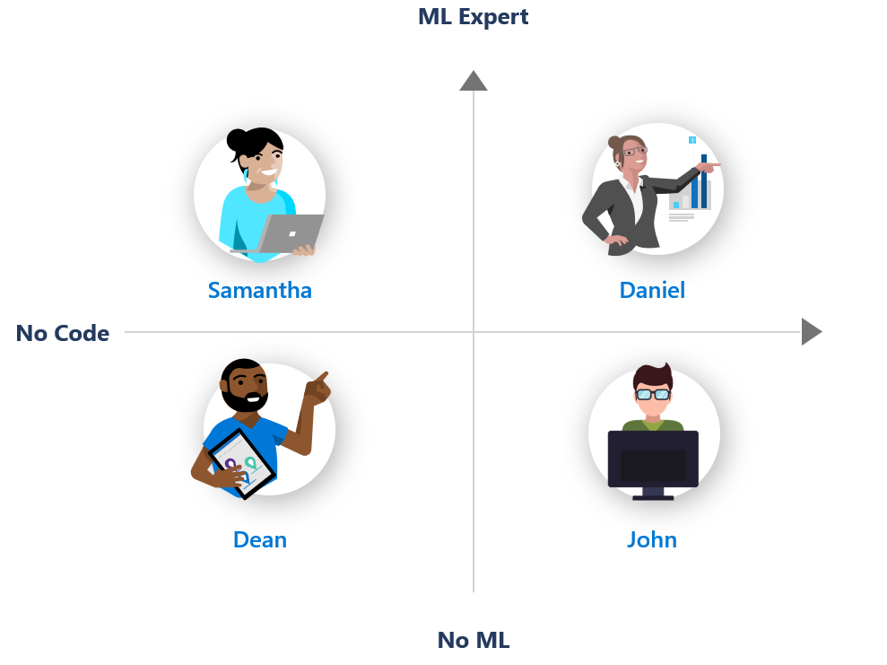

For all skills levels
Designer GUI
AutoML Wizard
Python SDK

Slide 5
Jupyter Notebooks?
https://notebooks.azure.com/
Notebook VMs in AzureML
On your local machine…
This is what most people do
Visual Studio Code

Slide 6





Libraries, Frameworks
Python / R
Notebooks
Data Stores on Prem

Slide 7
ML Workspace
Notes:
When you create a new workspace, it automatically creates these Azure resources:
Azure Container Registry - Registers docker containers that are used during training and when deploying a model.
Azure Storage - Used as the default datastore for the workspace.
Azure Application Insights - Stores monitoring information about your models.
Azure Key Vault - Stores secrets used by compute targets and other sensitive information needed by the workspace.

Slide 8
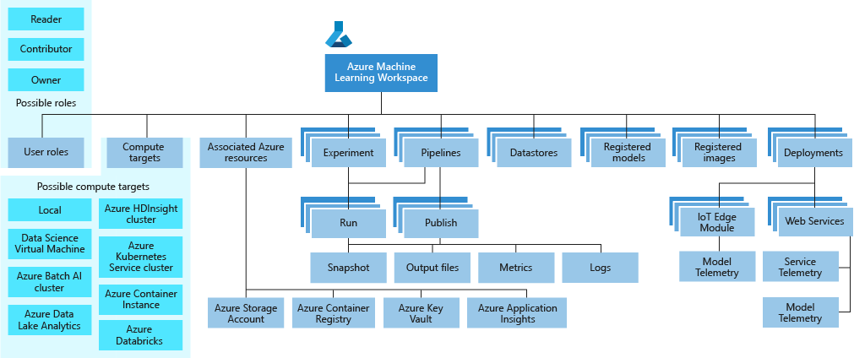
Azure ML service Workspace Taxonomy

Slide 9
Handling Data
Azure
File Share
File Data Set
Storage Account
Blob / Data Lake Gen2
Data Store
Data Sets
SQL / MySQL / Postgres
Database
Tabular Data Set
Data Sources
Pointers to Data Sources + Meta Data

Slide 10
Process Flow
Score Model
Unbiased
Validation
Validation
Offline
Copy
Tabular Data Set
Training
Experiment
Retrieve
Best Model
Register
Model
Deploy
Model
AutoML
Config
Compute
Target
Tags
Meta Data
Inference
Config

